Slide 1


STUDENT ID 7209
SMART CITY TRANSPORT SYSTEM
BY SANGITA JITENDRA GUPTA
FROM IVY PROFESSIONAL SCHOOL
DATA-DRIVEN INSIGHTS USING SQL

Slide 2


PROJECT OVERVIEW & OBJECTIVE
•• Identify the most gathered route based on trip count
.. Analyze passenger age profile for that route
.. Determine route with highest total fare collected
.. Compare fare/km to highlight cheapest & premium routes
.. Use CTEs, Ranking, and Window Functions for clean analysis
.. Deliver insights for transport optimization & revenue strategy

Slide 3

SAMPLE QUESTIONS & SOLUTIONS
WITH SeasonalTrips AS (
SELECT route_id,
CASE
WHEN MONTH(trip_date) IN (12, 1, 2) THEN 'Winter'
WHEN MONTH(trip_date) IN (3, 4, 5) THEN 'Summer'
WHEN MONTH(trip_date) IN (6, 7, 8) THEN 'Monsoon'
WHEN MONTH(trip_date) IN (9, 10, 11) THEN 'Autumn'
END AS season
FROM Trips
),
RankedRoutes AS (
SELECT
route_id,
season,
COUNT(*) AS total_trips,
RANK() OVER (PARTITION BY season ORDER BY COUNT(*) DESC) AS season_rank
FROM SeasonalTrips
GROUP BY route_id, season
)
SELECT *
FROM RankedRoutes
WHERE season_rank = 1;
1.FIND OUT THE SEASON WISE MOST GATHERED ROUTE?
QUERY :
RESULT :

Slide 4
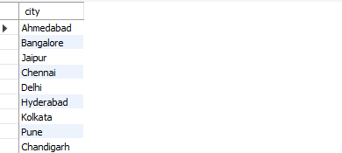

WITH MonthlyTrips AS (
SELECT
route_id,
DATE_FORMAT(trip_date, '%Y-%m') AS month
FROM Trips
),
RankedRoutes AS (
SELECT
route_id,
month,
COUNT(*) AS total_trips,
RANK() OVER (PARTITION BY month ORDER BY COUNT(*) DESC) AS month_rank
FROM MonthlyTrips
GROUP BY route_id, month
)
SELECT *
FROM RankedRoutes
WHERE month_rank = 1;
2. Month-Wise Most Gathered Route.?
QUERY :
RESULT :

Slide 5
WITH YearlyTrips AS (
SELECT
route_id,
YEAR(trip_date) AS year
FROM Trips
),
RankedRoutes AS (
SELECT
route_id,
year,
COUNT(*) AS total_trips,
RANK() OVER (PARTITION BY year ORDER BY COUNT(*) DESC) AS year_rank
FROM YearlyTrips
GROUP BY route_id, year
)
SELECT *
FROM RankedRoutes
WHERE year_rank = 1;
3. YEAR-Wise Most Gathered Route.?
QUERY :
RESULT :

Slide 6
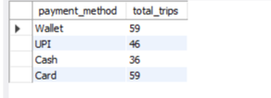
SELECT
CASE
WHEN fare < 30 THEN 'Below ₹30'
WHEN fare BETWEEN 30 AND 50 THEN '₹30–50'
WHEN fare BETWEEN 51 AND 75 THEN '₹51–75'
WHEN fare BETWEEN 76 AND 100 THEN '₹76–100'
ELSE 'Above ₹100'
END AS fare_group,
COUNT(*) AS total_trips,
ROUND(AVG(fare), 2) AS avg_fare,
ROUND(SUM(fare), 2) AS total_fare
FROM Trips
GROUP BY fare_group
ORDER BY total_fare DESC;
4. Group Trips by Fare Ranges.
QUERY :
RESULT :

Slide 7
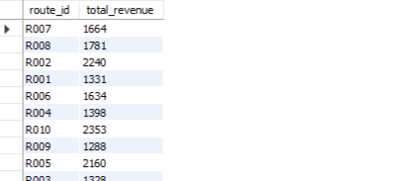
5. Highest earning route.
QUERY :
SELECT route_id,SUM(fare) AS total_earning
FROM Trips
GROUP BY route_id
ORDER BY total_earning DESC
LIMIT 1;
RESULT :

Slide 8
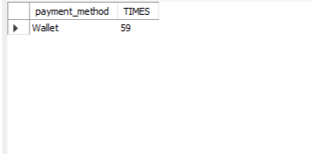
6 Single vs. Multiple Purchasers.
QUERY :
SELECT
P.passenger_id,
P.full_name,
COUNT(T.trip_id) AS total_trips,
CASE
WHEN COUNT(T.trip_id) = 1
THEN 'Single Purchase‘
ELSE 'Multiple Purchases‘
END AS purchase_type
FROM Passengers P
JOIN Trips T ON P.passenger_id = T.passenger_id
GROUP BY P.passenger_id, P.full_name
ORDER BY total_trips DESC;
RESULT :

Slide 9
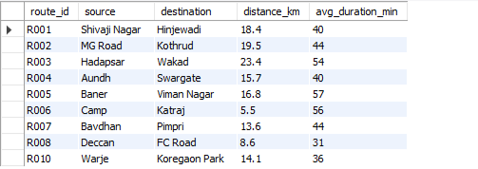
7. Rank Routes Based on Average Feedback.
QUERY :
SELECT route_id, AVG(feedback_rating) AS avg_rating, RANK() OVER (ORDER BY AVG(feedback_rating) DESC) AS route_rank
FROM Trips
GROUP BY route_id;
RESULT :

Slide 10


✅ Identified busiest route and key age demographics
1
Conclusion
💰 Analyzed fare revenue and cost-efficiency per route
2
THIS PROJECT DEMONSTRATES HOW SQL CAN TRANSFORM RAW DATA INTO ACTIONABLE INSIGHTS, HELPING BUSINESSES :
3
•Applied advanced SQL for deep data exploration

Slide 11
THANK YOU SO MUCH!

